Slide 1
What’s new with Argo data?
2022-2023
Claire Gourcuff, Megan Scanderbeg ADMT co-chairs
Tanya Maurer, Catherine Schmechtig BGC ADMT co-chairs
Fiona Carse, UK Met Office

Slide 2
Number of Argo profiles measured per year

Slide 3
Number of Argo profiles measured per year
For now, the number of core and BGC profiles per year is fairly stable while the number of Deep profiles is slightly increasing.
All Argo missions contribute core profiles.

Slide 4
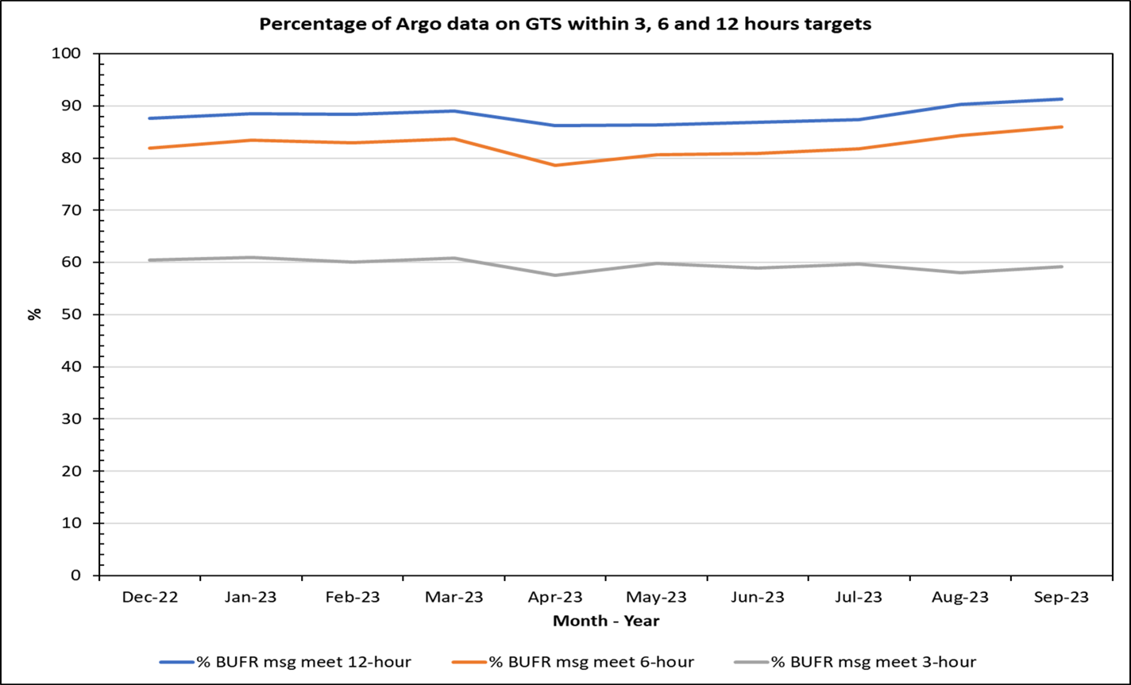
80% of core Argo data are now delivered in 6 hours

Slide 5
80% of core Argo data are now delivered in 6 hours
Argo DACs optimized their data delivery techniques to improve timeliness and over 80% of data is being delivered within 6 hours.
BUFR formats are currently being finalized for BGC parameters.

Slide 6
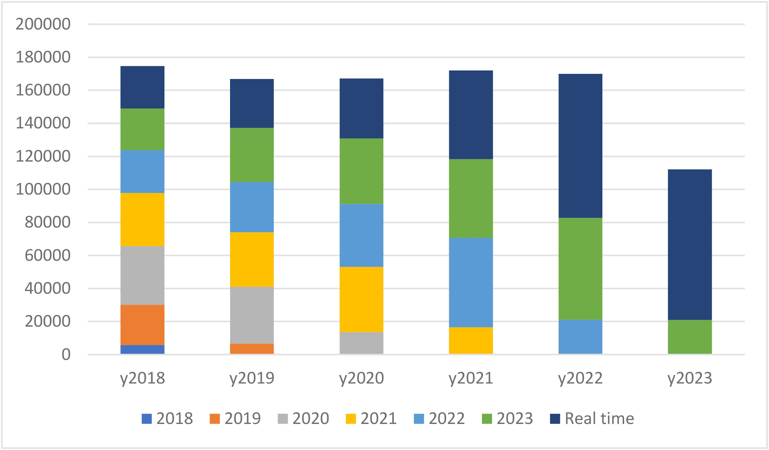
Argo is a living dataset
How often should I refresh the Argo data I use for research?
We recommend to refresh your Argo data yearly to take advantage of delayed mode quality control (DMQC).
DMQC is performed when enough information is available to make a thorough assessment of parameter accuracy and adjustment requirements (usually 12 - 24 months after measurement unless known sensor problems exist).
Number of Temperature and Salinity Argo Profiles measured in the past five years
year profile was measured
year dmode file was created/updated
* Does not include all measured profiles in 2023

Slide 7
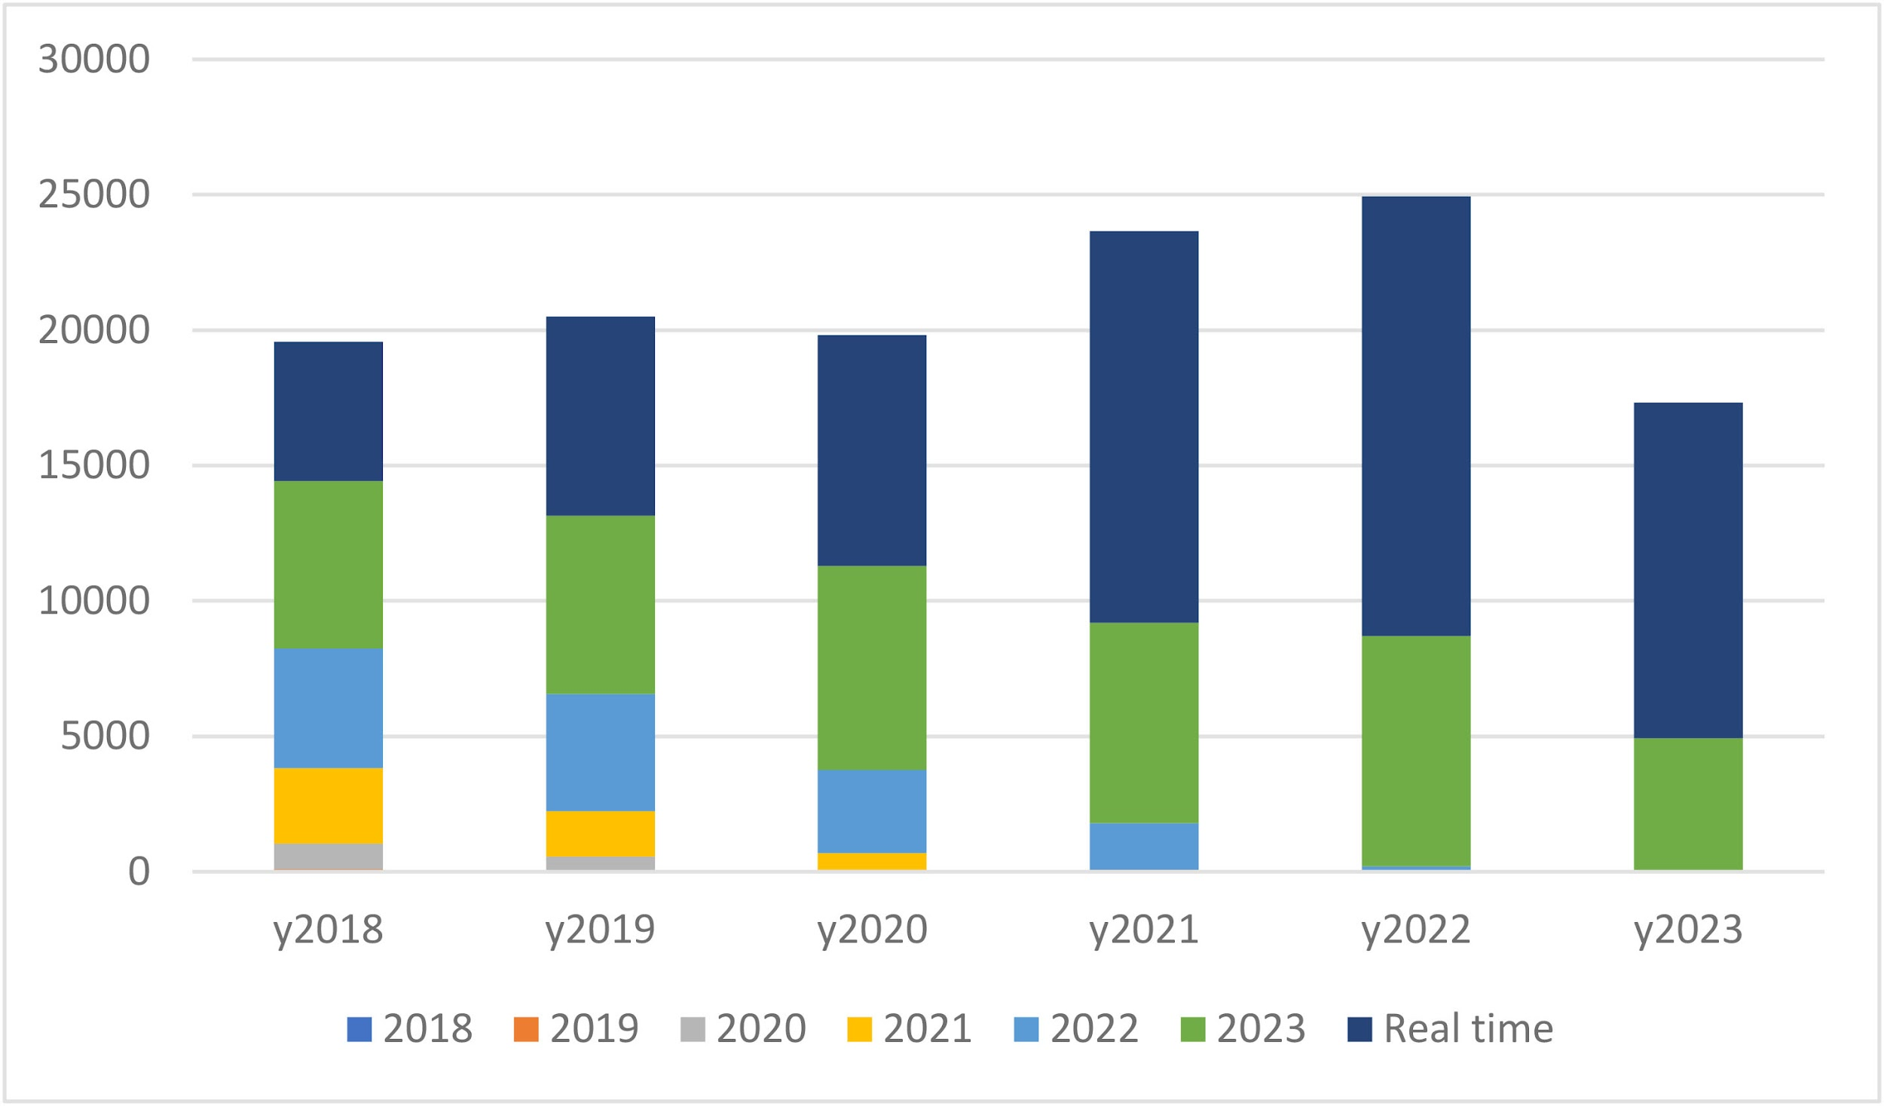
Argo is a living dataset
BGC Argo profiles are reprocessed more often than core profiles. Suggested to refresh every six months.
This is due to:
Updated decoding algorithms
Updated QC processing algorithms as methods continue to improve
Updated metadata information
Updated understanding of how sensors perform
Number of BGC Argo Profiles measured in past five years
year profile was measured
year dmode file was created/updated
* Does not include all measured profiles in 2023

Slide 8
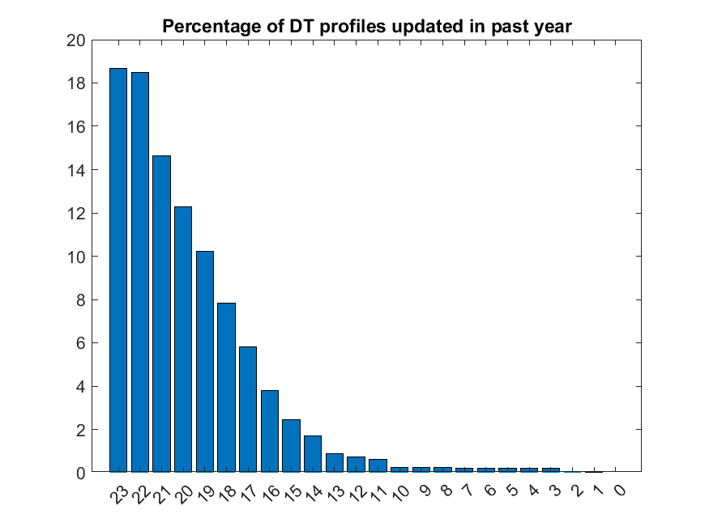
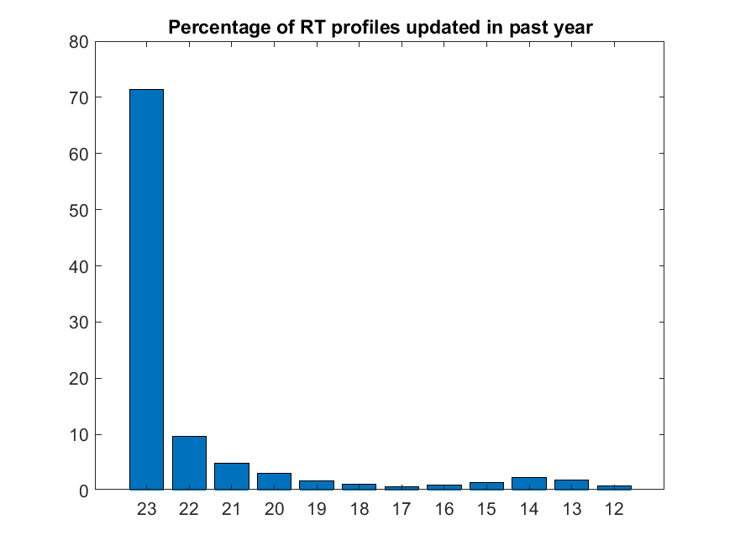
Argo is a living dataset
Refresh your Argo dataset prior to analysis
If you use Argo profiles from the GDACs, you can do the following to stay up to date:
Download a recent monthly DOI tarball: 10.17882/42182 (doi.org)
User rsync to keep your local mirror up to date: Argo GDAC synchronization service - Argo Data Management (argodatamgt.org)
Make a selection on the Argo data selection tool: https://dataselection.euro-argo.eu
Select Argo data via ERRDAP: www.ifremer.fr/erddap/index.html
If you use an Argo product created by a third party and listed on this webpage https://argo.ucsd.edu/data/argo-data-products/, be aware that the Argo data in that product may not be up to date. Contact the producers for more information.
Percent of profiles in past year
Year in which profile was taken
Year in which profile was taken

Slide 9
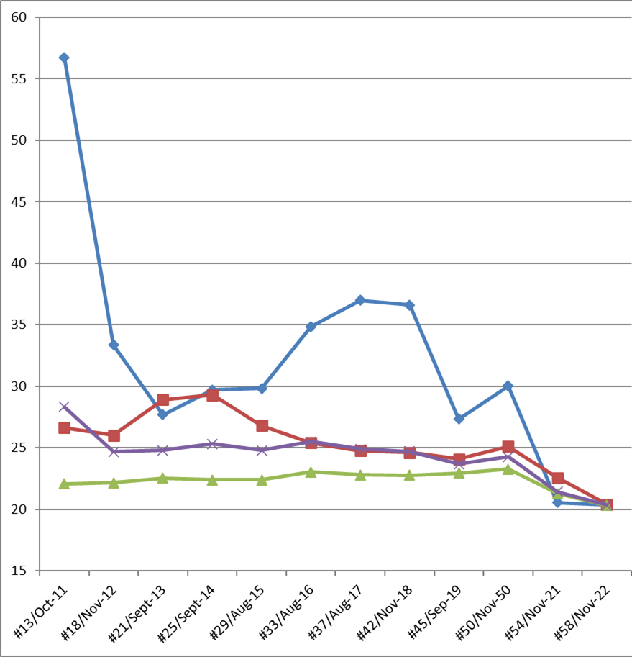
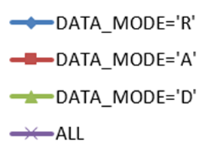
A validation example using altimetry
Comparison of Sea Level Anomaly (SLA) from altimetry and Dynamic Height Anomaly (DHA) from Argo shows that
Delayed mode data is more accurate
Real time errors are being removed from the data system via quality control flags

Slide 10
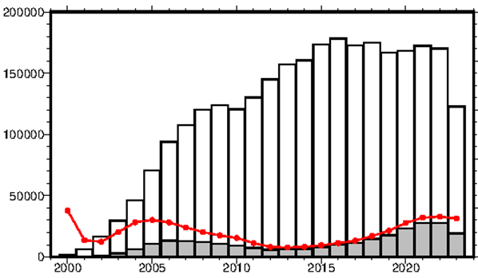
What is Abrupt Salty Drift? How often does it occur?
Abrupt Salinity Drift (ASD), or Fast Salinity Drift, affects the salinity in certain batches of serial numbers on SeaBird CTD sensors.
This issue results in earlier and more rapid salinity drift than what is normally expected. Floats that may suffer ASD are reviewed more frequently in delayed mode.
ASD concerns floats that were deployed between 2015 and 2019, mostly affecting salinity profiles measured between 2018 and now (see graph).
In 2018, the manufacturing process was changed and the problem seems to be resolved, although the status will continue to be closely monitored by the ADMT community.
Total number of salinity profiles
Number of bad salinity profiles (all measures are QC3 or 4)
Percentage of bad salinity profiles (all measures are QC3 or 4)

Slide 11
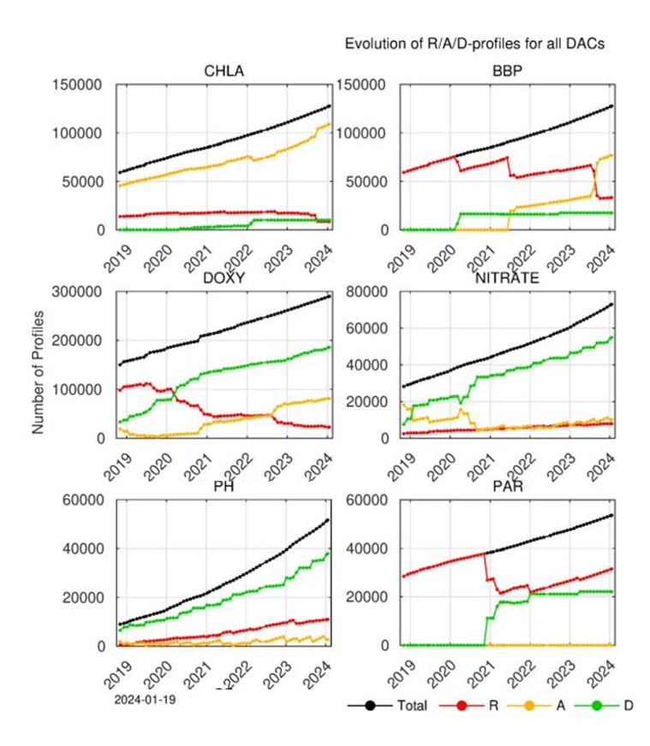
What is the status BGC Argo data quality?
Henry Bittig’s audit of BGC parameters from 2024/01/19 (https://biogeochemical-argo.org/cloud/document/implementation-status/) illustrates the status of the PARAMETER_DATA_MODE of the six principal BGC variables
In 2023, several Quality Control documents were updated:
QC document for BBP (https://doi.org/10.13155/60262)
QC document for CHLA (https://doi.org/10.13155/35385)
QC document fo pH (https://doi.org/10.13155/97828)
The application of the DM procedures and Adjustment in Real Time is an ongoing effort in the BGC-Argo community but the proportion of qualified data continues to increase.

Slide 12
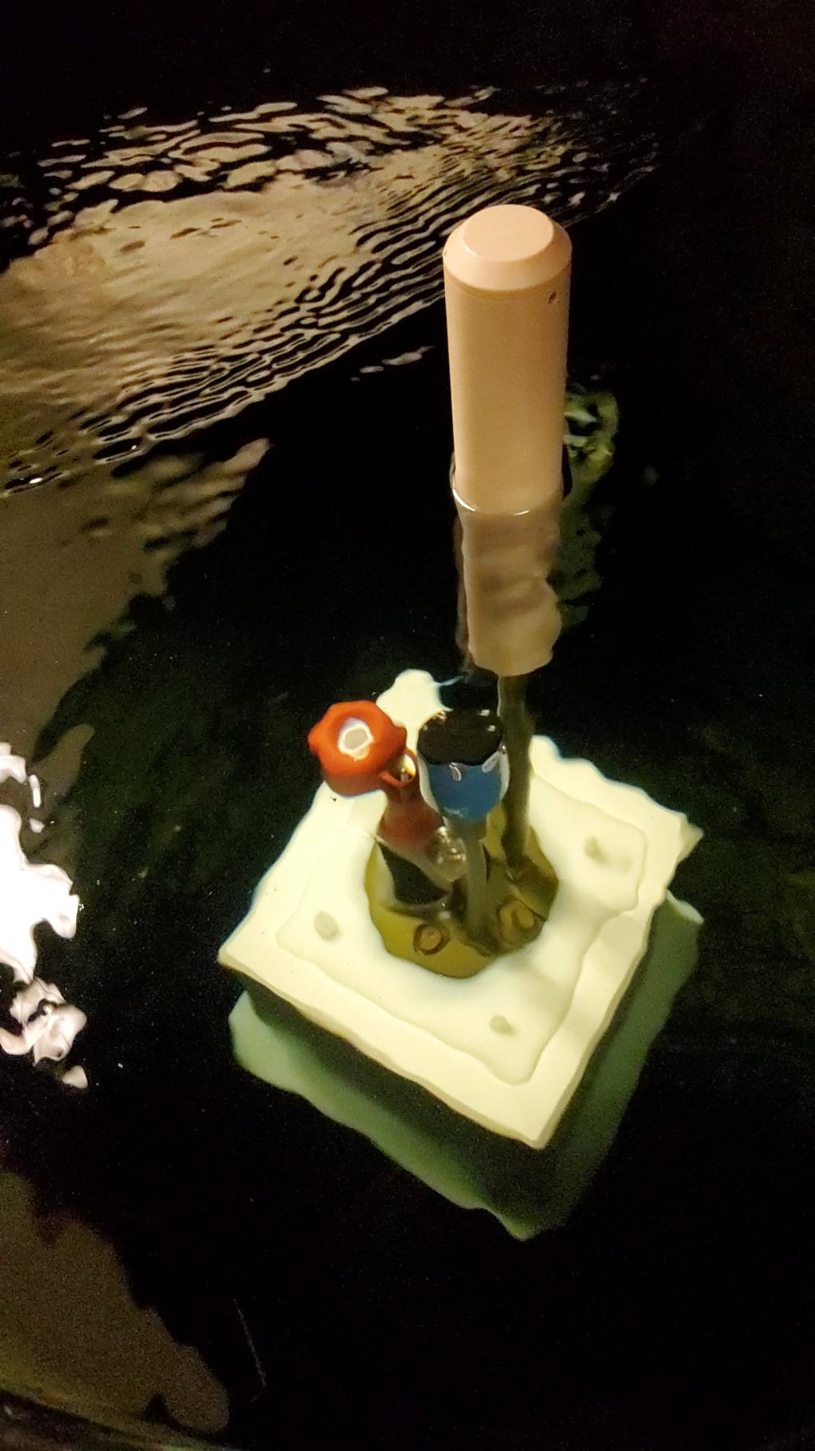
What is happening with the new RBR CTD?
More floats equipped with RBR CTDs (SENSOR_MODEL = RBR_ARGO, RBR_ARGO3) are being deployed and their data is being distributed in real time with the appropriate QC flags.
Delayed mode quality control methods are being established for RBR CTDs and implemented by DMQC experts, bringing accuracies to the expected level of other CTD models used in Argo.

Slide 13
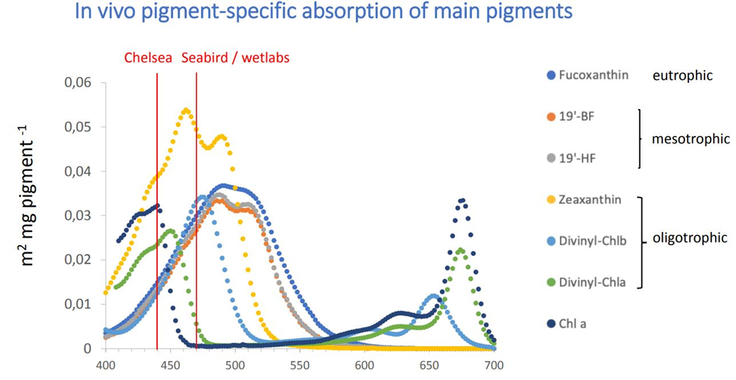
What sensors are new in BGC-Argo?
ECO_FLBBFLB
3-channel bio-optical sensor
Chla fluorescence (@470nm)
Chla fluorescence (@435nm)
Optical backscatter (@700nm)
Several FLBBFL sensors (Double Chla channels 435, 470) have been deployed in 2022, 2023
Data are available at the GDAC in the aux directory (14 floats at the Coriolis DAC, 2 floats at the aoml DAC)
Excitation at 435 nm target photosynthetic absorption (especially Chla)
FLUORESCENCE_CHLA435 is expected to be less variable with respect to CHLA than FLUORESCENCE_CHLA (excited at 470 nm)

Slide 14
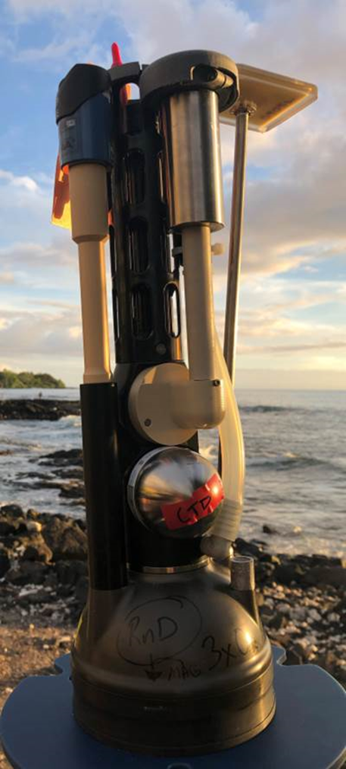
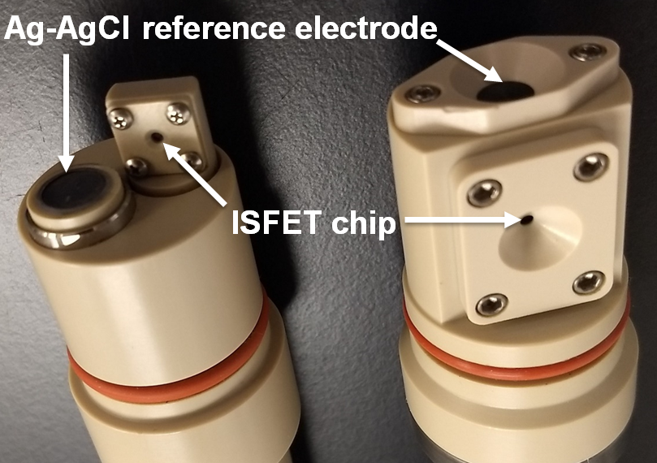
What sensors are new in BGC-Argo?
SBE83_OPTODE oxygen sensor
The new SBE oxygen optode capable of in-air sampling is now available and proliferating within the BGC-Argo system
Currently >10 AOML floats deployed with SBE83_OPTODE, data available at the GDAC
These sensors are pumped, allowing for faster response times than un-pumped optodes and thus reduced bias in the thermocline
In-air sampling allows for more accurate in-situ calibration
GDF (Gasket DuraFET) pH sensor
Newest pH sensor design in Argo, developed at MBARI
Same sensor elements & principle as the MBARI DURAFET, with a repackaged housing
Over 20 GDF sensors are currently in the Argo system and performing well; deployments planned to increase in 2024
DURAFET
GDF

Slide 15
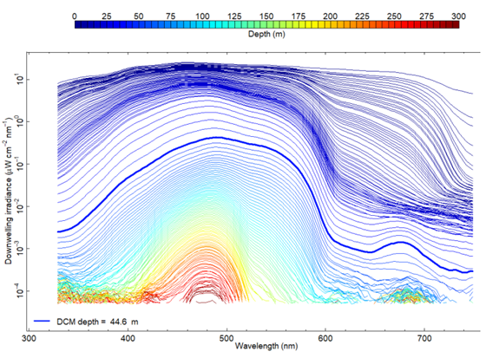
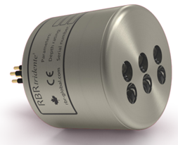
What new BGC sensors might be coming in the future?
Ramses sensors (Radiometry Hyperspectral)
▪ Ed, Lu
▪ Validation for the PACE mission
RBR tridente
▪ Fluorescence and BBP
▪ Diversify the sensor market

Slide 16
What new data is in Argo files?
v3.2 trajectory files
The trajectory files have been combined to include both core and BGC data in v3.2 trajectory files. This includes in-air oxygen measurements made at the surface and any BGC measurements made during drift. Expect more DACs to produce these files over the next year.
Profile files
Errors in position can be stored in the profile files using the following optional variables “POSITION_ERROR_REPORTED”, “POSITION_ERROR_ESTIMATED” and “POSITION_ERROR_COMMENT”.
NB_SAMPLE_CTD, NB_SAMPLE_<PARAMETER_SENSOR_NAME>, TEMP_CNDC, CNDC, MTIME added or moved to ‘intermediate core’ or ‘intermediate b’ category in physical parameters list. http://www.argodatamgt.org/content/download/30910/209488/file/argo-parameters-list-core-and-b_20230612.xlsx
More sophisticated methods of determining positions of under-ice profiles are being used in delayed mode to improve estimated positions. These estimated positions can be stored in both the profile files and the trajectory files.

Slide 17
Updates on accessing Argo data
Interested only in BGC data? Look no further than the monthly DOI snapshot which now includes a separate zip file containing all available *Sprof.nc files. http://doi.org/10.17882/42182

Slide 18
Updates on accessing Argo GDAC data
Want to select profiles with certain parameter(s) in time and space? Try the EuroArgo Selection tool: https://dataselection.euro-argo.eu/

Slide 19
Updates on accessing Argo data via database
Argovis (https://argovis.colorado.edu/ ) is a web app and RESTful API database allowing you to select and co-locate ocean datasets (including Argo, GO-SHIP, drifters and more) and bring them into your own computing environment. Jupyter notebooks are available to help you get started (https://github.com/argovis/demo_notebooks ).

Slide 20
Need help using Argo data? Try these tools!
These tools allow you to select Argo netCDF files and bring them into your programming language of choice for further analysis. They remove the difficulty of understanding the Argo netCDF format and helps you choose the best data quality for your research.
Argo Online School (https://euroargodev.github.io/argoonlineschool/intro.html) which has Jupyter notebooks in Python and introduces how to access data by float, file type and date
Argopy: an Argo data Python library to access, manipulate and visualize data (https://github.com/euroargodev/argopy )
argoFloats: an R package to download and analyze Argo data (https://github.com/ArgoCanada/argoFloats )
OneArgo float toolboxes in Matlab (https://github.com/NOAA-PMEL/OneArgo-Mat ) and R (https://github.com/NOAA-PMEL/OneArgo-R )
Argovis Jupyter notebooks in Python: (https://github.com/argovis/demo_notebooks )
See all tools here: https://argo.ucsd.edu/data/argo-software-tools/

Slide 21
Have more questions or want to stay up to date?
Email us at argo@ucsd.edu with your questions or feedback.
Find the latest announcements via the Argo email lists: https://argo.ucsd.edu/stay-connected/
Technical updates on the Argo data stream are posted here: https://argo.ucsd.edu/category/status/
Visit our Data FAQ for all things Argo data related: https://argo.ucsd.edu/data/data-faq/
How to cite Argo data: https://argo.ucsd.edu/data/acknowledging-argo/
Thank you for using Argo data and please let us know if we can help.

